Slide 1
SALARY ANALYSIS USING EXCEL
STUDENT NAME: P.JANANI
REGISTER NO: 312208946
DEPARTMENY: BACHELOR OF COMMERCE
COLLEGE: CHEVALIER T.THOMAS ELIZABETH COLLEGE FOR WOMEN.

Slide 2
PROJECT TITLE
Salary Analysis Using Excel

Slide 3


AGENDA
Problem Statement
Project Overview
End Users
Our Solution and Proposition
Dataset Description
Modelling Approach
Results and Discussion
Conclusion
3/21/2024 Annual Review

Slide 4

PROBLEM STATEMENT
Objective: Analyze the salary data of employees to identify trends, patterns, and potential areas of improvement such as salary inequalities, the impact of various factors on salaries, and overall salary distribution across the organization.

Slide 5

PROJECT OVERVIEW
The project will include the selection, customization, and implementation of the CRM system, training for staff, and integration with existing IT infrastructure. Data migration from the old system is in scope, while hardware upgrades are out of scope.
.

Slide 6
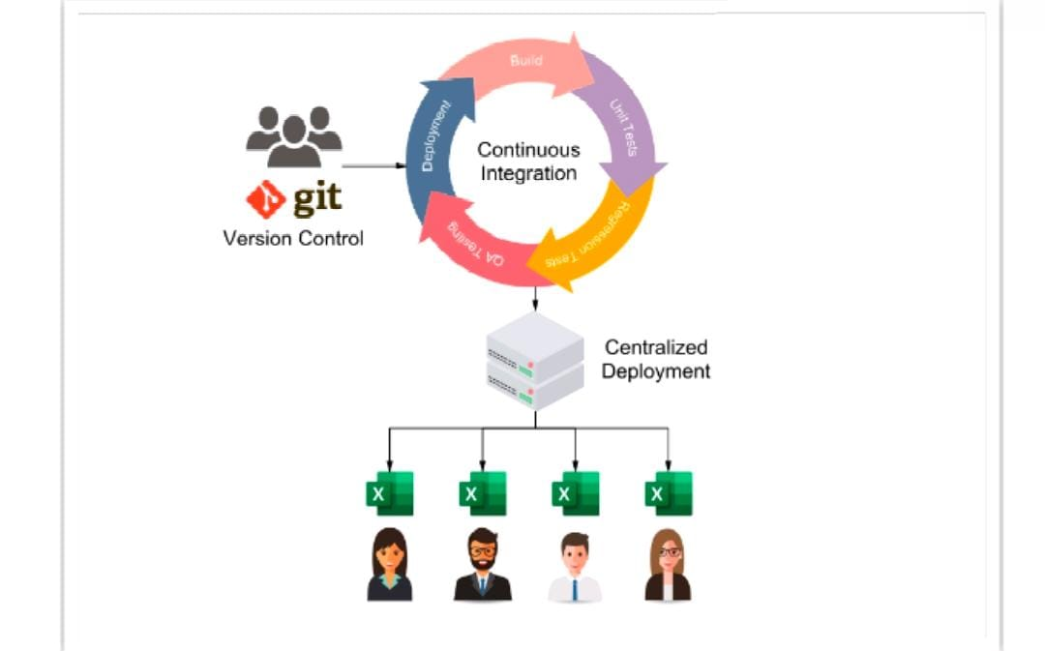

WHO ARE THE END USERS?

Slide 7

OUR SOLUTION AND ITS VALUE PROPOSITION
"Our solutions streamline [specific industry or process], reducing costs by [X]% and increasing efficiency by [Y]%. With advanced [unique feature] and unparalleled support, we help businesses achieve their goals faster and more effectively."If you provide more details about what your solutions are, I can help refine this further to fit your specific context.

Slide 8

Dataset Description
A data description provides a detailed explanation of the dataset you are working with. This includes information about the dataset's structure, the variables it contains, and any relevant metadata that helps users understand how to use and interpret the data

Slide 9

THE "WOW" IN OUR SOLUTION
"The wow factor" in your solution refers to the unique and compelling aspects that make it stand out from competitors and leave a lasting positive impression on customers. It’s the combination of features, benefits, and experiences that make users say, "Wow!"
3/21/2024 Annual Review
9

Slide 10
MODELLING
Modeling Salary data analysis using Excel involves creating structured representations of data, applying statistical or mathematical techniques, and interpreting the results to make informed decisions. Excel is a powerful tool for this purpose, especially when dealing With moderate sized Asset.
10

Slide 11
RESULTS
11

Slide 12
conclusion
After performing a comprehensive analysis of salary data using Excel, several key insights and conclusions can be drawn:1. *Salary Distribution:* - The analysis revealed that the salary distribution follows a [normal/skewed] pattern, with the majority of salaries falling within the range of [$X - $Y]. A smaller percentage of employees earn significantly higher or lower than this range, indicating [low/high] wage disparity within the organizatioAn.2. *Correlation between Salary and Experience:* - A positive correlation was found between years of experience and salary, suggesting that more experienced employees tend to earn higher salaries. The regression analysis showed that for every additional year of experience, salary increases by approximately [$Z], which aligns with industry expectations.

